Slide 1
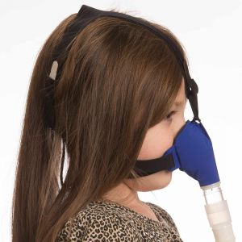
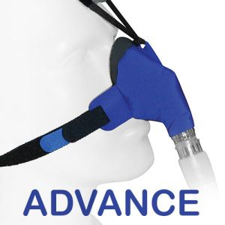
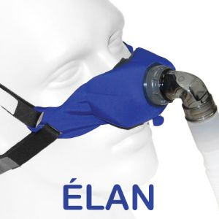

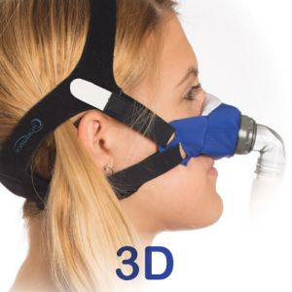

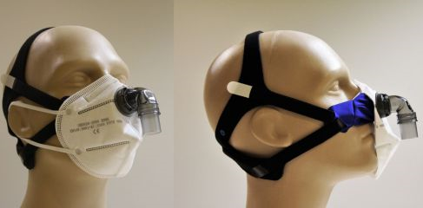
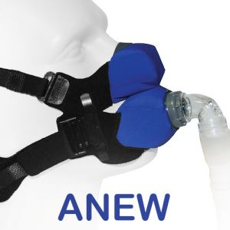
EXPANDING SLEEP LAB PAP SERVICES
FOR THE CLINICAL SLEEP EDUCATOR
A CIRCADIANCE SleepWeaver
CSE CPAP COMPLIANCE INITIATIVE
The following program is provided by Circadiance, the maker of the SleepWeaver line of skin-friendly, all-cloth masks.
It is intended to support and enhance the role of the CSE by providing a broad set of tools befitting the role to promote patient compliance with CPAP treatment for OSA.
Expanding Sleep Lab PAP Services contains best practices and billing codes to model a longitudinal approach to PAP treatment at your Sleep Disorders center.

Slide 2
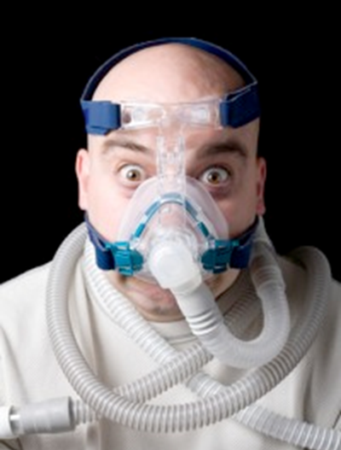
PAP THERAPY:
THE PROBLEM IS ADHERENCE
Internationally some 5-50% of OSAHS patients recommended CPAP either reject this treatment option or discontinue use within the first week.
12 to 25% of the remaining patients may be expected to have discontinued its use at 3 years.

Slide 3

EXPANDED SERVICES FOR THE CSE
↑ IN-NEED PATIENT POPULATIONS
“INTERVENTIONAL” APPROACH & CODING
  PAP DESENSITIZATION
  REMOTE MONITORING
DEVELOPING A LONGITUDINAL MODEL
IMPROVING PATIENT OUTCOMES
BENEFITS TO THE BOTTOM LINE

Slide 4
“IN-NEED” PATIENT POPULATIONS
  CLAUSTROPHOBIA; INSOMNIA; (FAILED CPAP)
  AUTO-BILEVEL
  SEVERE OSA
  OBESITY HYPOVENTILATION SYNDROME
  MORBID OBESITY
  HIGH ACUITY PATIENTS REQUIRING 1:1 CARE:
      ALL MUST MEET SAFETY INTAKE CRITERIA
    INPATIENTS
    NURSING HOMES
    NEUROMUSCULAR DISEASE
    VENTILATOR TRANSITION TO BILEVEL
Krakow, B., Ulibarri, V., Melendrez, D., Kikta, S., Togami, L., & Haynes, P. (2008). A daytime, abbreviated cardio-respiratory sleep study (CPT 95807-52) to acclimate insomnia patients with sleep disordered breathing to positive airway pressure (PAP-NAP). JCSM, 4(3), 212–222.

Slide 5
GAPS IN THE CLINICAL PATHWAY
PATIENT EDUCATION
THOROUGHNESS OF FIRST NIGHT
“HANDS-ON” CARE FROM TRAINED, CREDENTIALED, SLEEP STAFF
DESENSITIZATION
ADDITIONAL GAPS IN CARE?

Slide 6
BEHAVIORAL SLEEP MEDICINE
SDB IS A MIND-BODY DISORDER
  BEHAVIORAL: mask and pressure desensitization
  PSYCHOLOGICAL: mental imagery to divert patient attention from mask or pressure sensations
  PHYSIOLOGICAL: exposure to PAP therapy
Krakow, B., Ulibarri, V., Melendrez, D., Kikta, S., Togami, L., Haynes, P. (2008). A daytime, abbreviated cardio-respiratory sleep study to acclimate insomnia patients with sleep disordered breathing to positive airway pressure (PAP-NAP). J Clin Sleep Med, 4,212-22.
Haniffa M, Lasserson TJ, Smith I (2004). Interventions to improve compliance with continuous positive airway pressure for obstructive sleep apnoea (Review). The Cochrane Database of Systematic Reviews, Issue 4 Art No: CD003531-pub2.
Lewis KE et al. (2004). Early predictors of CPAP use for the treatment of sleep apnea. Sleep, 27, 134-138.

Slide 7
EXPANDED SERVICES FOR THE CSE
↑ IN-NEED PATIENT POPULATIONS
“INTERVENTIONAL” APPROACH & CODING
  PAP DESENSITIZATION
  REMOTE MONITORING
DEVELOPING A LONGITUDINAL MODEL
IMPROVING PATIENT OUTCOMES
BENEFITS TO THE BOTTOM LINE

Slide 8
“TRANSFORMING” THE SLEEP LAB
CHANGE IN PERSPECTIVE: FROM “SLEEP TEST” TO “TREATMENT PROCEDURE”
SLEEP LABS ARE MOVING BEYOND DIAGNOSTIC AND TOWARD INTERVENTIONAL PROGRAMS

Slide 9
EARLY ATTEMPTS TO TRANSFORM THE CARE MODEL
VIDEO
SLEEP EDUCATION
SMARTPHONE APPS FOR INSOMNIA / COMPLIANCE
BEHAVIORAL SLEEP MEDICINE-BASED
PAP-NAP
95807-52
CPAP INITIATION AND MGMT
94660
TELEMEDICINE
EMAIL
E-CONSULTS
GOOGLE GLASS
DATA CARD DOWNLOAD

Slide 10
TWO PATIENT VISIT TYPES
E/M VISIT
OCCUR SAME DAY AS PHYSICIAN CLINIC VISIT
PATIENT MUST BE PRESENT
SINGLE, BUNDLED REIMBURSEMENT
SEPARATE VISIT
OCCUR ON SEPARATE DAY FROM PHYSICIAN VISIT
PATIENT DOES NOT HAVE TO BE PRESENT
SEPARATE PAYMENT BASED ON CPT CODE BILLED

Slide 11
NON-E/M VISITS
MASK ACCOMMODATION
NON-FACE-TO-FACE SERVICES (PAP REMOTE MONITORING)

Slide 12
EXPANDED SERVICES FOR THE CSE
↑ IN-NEED PATIENT POPULATIONS
“INTERVENTIONAL” APPROACH & CODING
  PAP DESENSITIZATION
  REMOTE MONITORING
DEVELOPING A LONGITUDINAL MODEL
IMPROVING PATIENT OUTCOMES
BENEFITS TO THE BOTTOM LINE

Slide 13
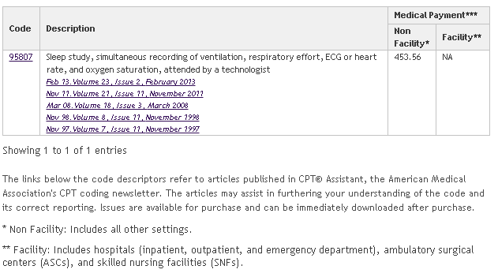
95807-52 PAP-NAP
SOURCE: AMERICAN MEDICAL ASSOCIATION

Slide 14
PAP-NAP PROCEDURE
Step 1: Pre Test Instructions
PREVIOUS NIGHT SLEEP RESTRICTION
Step 2: Introduction of PAP therapy and Barrier Assessment
MASK FITTING
PRESSURE DESENSITIZATION
ADDRESS WEAK MENTAL IMAGERY SKILLS
Step 3: PAP Therapy Hookup
10-CHANNEL HOOKUP FOR PATIENT COMFORT
Step 4: PAP Therapy Testing
1-2 HOURS EXPOSURE TO PAP
SUCCESS DETERMINED BY PATIENT’S ABILITY TO TOLERATE PAP
Step 5: Post-Test Follow-Up
ASSESS PATIENT’S MOTIVATION TO COMPLETE FULL-NIGHT TITRATION / SPLIT
SCHEDULE THERAPEUTIC STUDY

Slide 15
95807-52 PAP-NAP: A WORD OF CAUTION!
Can 95807-52 be used for an attended CPAP acclimation, referred to as PAP-Nap?
There are no codes in the CPT codebook that specifically describe the PAP-Nap service. Some physicians have reported receiving reimbursement for PAP-Naps coded as 95807-52 in their area. However, that code only approximately reflects the service that is being performed. The modifier 52 indicates reduced services (less than the complete 95807 service is being performed).
Coding FAQ. (n.d.). Retrieved May 21, 2019, from https://aasm.org/clinical-resources/coding-reimbursement/coding-faq/

Slide 16
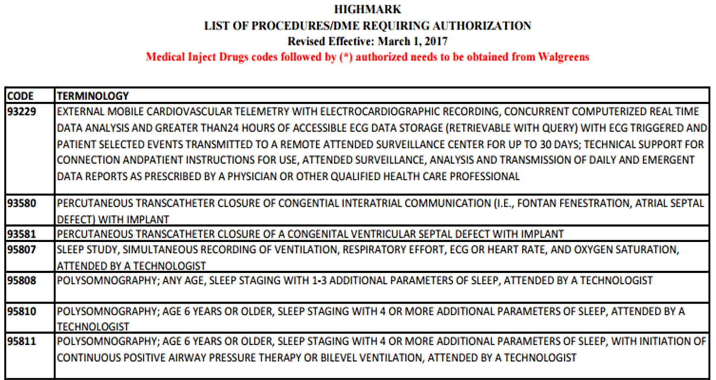
95807-52 PAP-NAP REQUIRES
INSURANCE PREAUTHORIZATION
SOURCE: HIGHMARK, INC.

Slide 17
94660: APPROVED IN 2015 MEDICARE CPT REVIEW
94660- “CPAP Initiation and Management.” This code was originally used for bi-level therapy in the ICU. However, at its most recent CPT review, it was changed to include PAP acclimation as an outpatient…. —2015 BRPT CCSH Reimbursement Guide

Slide 18
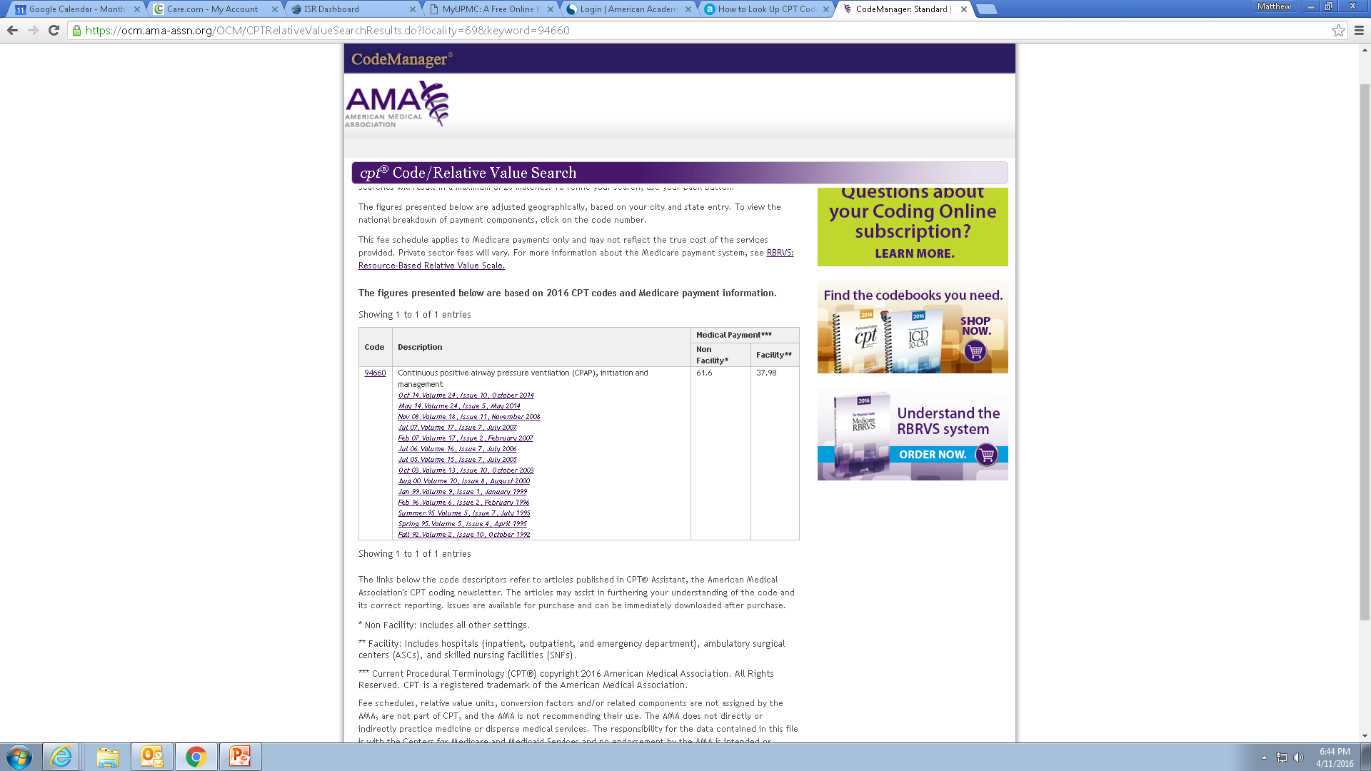
94660 CPAP INITIATION AND MANAGEMENT
SOURCE: AMERICAN MEDICAL ASSOCIATION

Slide 19

94660, A BETTER ALTERNATIVE TO 95807-52?
CPT 95807-52 “PAP-NAP”
  SLEEP STUDY, SIMULTANEOUS RECORDING OF VENTILATION, RESPIRATORY EFFORT, ECG OR HEART RATE, AND OXYGEN SATURATION, ATTENDED BY A TECHNOLOGIST
  LESS THAN 6 HOURS RECORDING TIME
  REQUIRES INSURANCE PREAUTHORIZATION.
  RESEMBLES A “TEST”
CPT 94660 “MASK ACCOMMODATION”
  CPAP INITIATION AND MANAGEMENT
  NO PREAUTH NEEDED!
  RESEMBLES AN “INTERVENTION”

Slide 20
94660 MASK ACCOMMODATION
REQUIRED STAFF
HEALTHCARE PERSONNEL
PHYSICIAN OVERSIGHT
LOCATION
REQUIREMENT
NONE

Slide 21
94660 MASK ACCOMMODATION STEPS
1-HOUR INTERVENTION
PAP EDUCATION
  INTERFACE ADJUSTMENT & CLEANING, ETC.
DESENSITIZATION
  HABITUATION
ADDRESS BARRIERS TO COMPLIANCE
  INTERFACE AND PRESSURE CHANGES
PSYCHOLOGICAL EXPOSURE
MOTIVATIONAL ENHANCEMENT THERAPY (MET)
  FOCUS ON GOALS
  OVERCOME BARRIERS TO COMPLIANCE
Journal Club # 20: Motivational Enhancement Therapy for PAP Adherence. AAST Journal Club. Richard Rosenberg, Jan, 2014. www.aastweb.org
Aloia,MS, DiDio,P, Ilniczky, N. Perlis,ML, Greenblatt, DW, & Giles, DE (2001). Improving compliance with nasal CPAP and vigilance in older adults with OSAHS. Sleep and Breathing, 5, 13–21.

Slide 22
94660 AND THE “INTERVENTIONAL” SLEEP LAB MODEL
GOALS/ADVANTAGES OF DAYTIME INTERVENTION:
BEHAVIORAL AND PSYCHOLOGICAL MASK DESENSITIZATION TECHNIQUES
TIME AND RESOURCES
DATA CARD DOWNLOAD CAPABILITY
ON THE SPOT PHYSICIAN EVALUATION/ORDER
1:1 CARE OPPORTUNITIES
REDUCED STRESS SETTING
GAPS IN CARE AND ↑ “IN-NEED” PATIENTS CALL FOR A CPAP INITIATION AND MANAGEMENT SERVICE.

Slide 23
ADVANTAGES OVER MASK FITTING DURING PSG:
Brief, daytime, less threatening exposure to pressurized airflow
Meaningful desensitization trial of masks in sleep or recumbent position
Identify and manage behavioral factors (emotional conflicts or imagery deficits)
The sleep specialist is available to assist.
The procedure is reimbursable under existing CPT codes
Introduce BSM concepts into daytime CPAP clinics.

Slide 24
EXAMPLES OF USING 94660 IN THIS MODEL
Transition
Transition patients from HSAT portables to APAP or in-lab Therapeutic sleep studies.
Prevent
Prevent denials by insurers due to patients not meeting adherence minimums, and in more complex cases…
Transfer
Transfer patients on ventilatory treatment to AVAPs/iVAPs or BiLevel treatment.

Slide 25
EXPANDED SERVICES FOR THE CSE
↑ IN-NEED PATIENT POPULATIONS
“INTERVENTIONAL” APPROACH & CODING
  PAP DESENSITIZATION
  REMOTE MONITORING
DEVELOPING A LONGITUDINAL MODEL
IMPROVING PATIENT OUTCOMES
BENEFITS TO THE BOTTOM LINE

Slide 26
REMOTE PHYSIOLOGICAL MONITORING (RPM)
CPT 99091
ORDERED BY PHYSICIAN / QHCP
SERVICE PROVIDED BY PHYSICIAN / QHCP
> 30 MINUTES FOR REVIEW, INTERP & INTERACTION
CPT 99457
ORDERED BY PHYSICIAN / QHCP
SERVICE CAN ALSO BE PERFORMED BY CLINICAL STAFF
>20 MINUTES LIVE, INTERACTIVE COMMUNICATION BETWEEN PATIENT / CAREGIVER AND STAFF

Slide 27
HOW DO WE BILL FOR THIS?
SITUATION: DOES IT MATTER IF A MASK ACCOMMODATION OCCURS IN A SLEEP LAB, NURSING HOME OR OFFICE?
ANSWER: NO, 94660 HAS NO SITE OF SERVICE RESTRICTIONS
SITUATION: MAY I BILL BOTH AN E/M AND 94660 ON THE SAME DAY?
ANSWER: NO, IF BOTH OCCUR THEN E/M CODE IS BILLED

Slide 28
HOW DO WE BILL FOR THIS?
SITUATION: MAY A 94660 BE BILLED TWICE WITHIN THE SAME CALENDAR MONTH?
ANSWER: YES, BUT RPM MAY ONLY BE BILLED ONCE PER CALENDAR MONTH.
SITUATION: TECHNICIAN COMPLETES A CPAP DATA-CARD DOWNLOAD AND A PHYSICIAN OR QHCP INTERPRETS IT.
ANSWER: BILLABLE FOR 99457, ONLY IF PERFORMED ON A DAY OTHER THAN E/M OFFICE VISIT WITH PHYSICIAN.

Slide 29
EXPANDED SERVICES FOR THE CSE
↑ IN-NEED PATIENT POPULATIONS
“INTERVENTIONAL” APPROACH & CODING
  PAP DESENSITIZATION
  REMOTE MONITORING
DEVELOPING A LONGITUDINAL MODEL
IMPROVING PATIENT OUTCOMES
BENEFITS TO THE BOTTOM LINE

Slide 30
JUSTIFICATION FOR CSE / CCSH DAY POSITION
BILLABLE AMOUNT
94660= $618 (commercial)
99457= $52 (CMS)
COLLECTABLE AMOUNT
$100-$500/PATIENT
WAGES AT $30/HR
$240/DAY
TOTAL COST W/BENEFITS
$312/DAY
HOW MANY PATIENTS JUSTIFY 1FTE HIRE?

Slide 31
EXPANDED SERVICES FOR THE CSE
↑ IN-NEED PATIENT POPULATIONS
“INTERVENTIONAL” APPROACH & CODING
  PAP DESENSITIZATION
  REMOTE MONITORING
DEVELOPING A LONGITUDINAL MODEL
IMPROVING PATIENT OUTCOMES
BENEFITS TO THE BOTTOM LINE

Slide 32
BEST PRACTICES—“INTERVENTIONAL” APPROACH
HAVE A SLEEP PHYSICIAN WRITE ORDERS AND ON-SITE
DEVELOP NEW INTERPRETATION REPORTS FROM TECH-ENTERED DATA
DOWNLOAD COMPLIANCE DATA AT EACH VISIT
DME PERMISSION FOR ON THE SPOT PRESSURE / SETTINGS CHANGES (PER PHYSICIAN ORDER)
COUNSEL ON SLEEP HYGIENE
PERFORM MASK-FITTING EDUCATION AND ASSESS FOR LEAKS
CONSULT WITH YOUR BILLING/CODING DEPT
NEVER BILL SEPARATE FROM E/M VISIT ON SAME DAY
CHECK WITH YOUR LCD FOR COMPLIANCE WITH ALL GOV’T PAYOR REQUIREMENTS

Slide 33
EXPANDED SERVICES FOR THE CSE
↑ IN-NEED PATIENT POPULATIONS
“INTERVENTIONAL” APPROACH & CODING
  PAP DESENSITIZATION
  REMOTE MONITORING
DEVELOPING A LONGITUDINAL MODEL
IMPROVING PATIENT OUTCOMES
BENEFITS TO THE BOTTOM LINE

Slide 34
LAB BENEFITS OF A TRANSFORMED CARE MODEL
DIVERSIFIED BILLING $ OPPORTUNITIES
BETTER INTEGRATION WITH…
OUTPATIENT CLINIC
DME
DIRECT REFERRING PRACTICES
INTERDISCLIPLINARY CARE TEAM
INPATIENT FLOOR
CAPTURE ↑ PATIENT VOLUME
OVERALL ↑ IN SLEEP TESTING

Slide 35
MOST IMPORTANTLY, EXPANDING SERVICES BENEFITS PATIENTS!
ADDS “INTERVENTIONAL” APPROACH TO CONNECT TESTING/TREATMENT PROCEDURES
PROVIDES COMPLETE TREATMENT FOR OUR PATIENTS
MEETS PROVIDER & ACUITY CHALLENGES
…AND…
PROMOTES ROBUST AND VIABLE SLEEP PROGRAMS
  (WITHOUT WHICH, PATIENTS HAVE NO WHERE ELSE TO GO!)

Slide 36

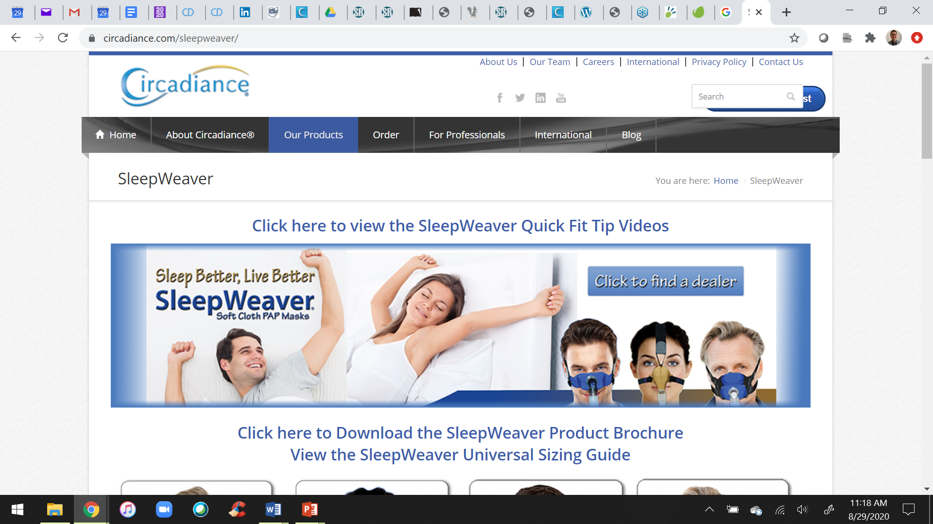
NOW, GO BACK AND “TRANSFORM” YOUR SLEEP CENTERS!
Do you have any questions?
Visit us online:
https://circadiance.com/sleepweaver/
Email us: info@circadiance.com
Visit us on LinkedIn:
https://www.linkedin.com/company/circadiance/
Visit us on Facebook:
https://www.facebook.com/SleepWeaver

